Slide 1
HDDS1104 Operating Systems and Networking
Topic 6 - Data Link Layer Services

Slide 2
Intended Learning Outcomes
Describe the Error detection and recovery
Medium Access Control (MAC)
Ethernet and securing the Ethernet

Slide 3
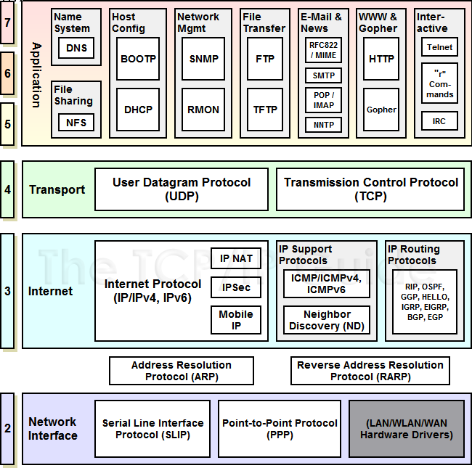
TCP / IP Protocols
Notes:
Source: http://www.tcpipguide.com/free/t_TCPIPProtocols.htm

Slide 4
Link Layer Services
Hop to Hop Delivery
NIC to NIC
NIC to Router NIC
Multiple Access
Multiple users sharing a wire
Duplex Operation

Slide 5
Link Layer Services - Lossy wireless links
Flow Control
Error Detection/Correction
Reliable Delivery

Slide 6
Error Detection
Use of redundancy bits
Additional bits for error detection
Popular techniques
Simple parity check
Two-dimensional parity check
Checksum
Cyclic Redundancy Check (CRC)

Slide 7
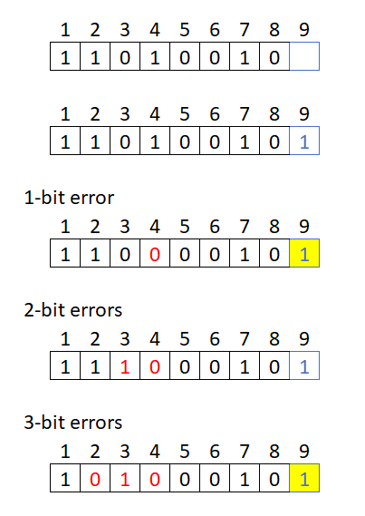
Simple Parity Checks
Even Parity
Before transmission, both the sender and receiver agree on a specific parity protocol (even or odd).
Sender's Role: The sender counts the number of '1's in the data.
Even Parity: If the count is odd, the parity bit is set to 1 to make the total number of '1's even. If the count is already even, the parity bit is 0.
Odd Parity: If the count is even, the parity bit is set to 1 to make the total number of '1's odd. If the count is already odd, the parity bit is 0.
Receiver's Role: The receiver counts the number of '1's in the received data, including the parity bit.
If the final count matches the agreed-upon parity (e.g., is even in an even parity system), the data is considered likely error-free.
If the count does not match the expected parity, an error has occurred during transmission.
Upon detecting an error, the receiver cannot identify which specific bit was corrupted, so it typically requests retransmission of the entire data packet.

Slide 8
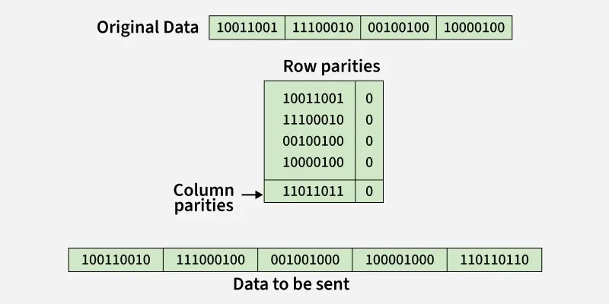
Two-Dimensional Parity check
https://www.geeksforgeeks.org/computer-networks/error-detection-in-computer-networks/
https://piyuscs.com/two-dimensional-parity-check/

Slide 9
Checksum
data is divided into k segments each of m bits.
In the sender’s end
segments are added
using 1’s complement arithmetic
to get the sum.
sum is complemented to get the checksum.
checksum segment is sent along with the data segments.
At the receiver’s end,
all received segments are added using 1’s complement arithmetic to get the sum.
The sum is complemented.
If the result is zero,
the received data is accepted;
otherwise discarded.
https://www.geeksforgeeks.org/computer-networks/error-detection-in-computer-networks/
https://www.geeksforgeeks.org/computer-networks/error-detection-code-checksum/
https://www.cuemath.com/numbers/binary-addition/

Slide 10
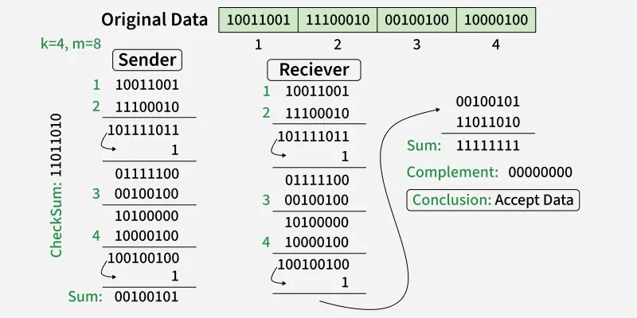
Example of Checksum
Source: https://www.geeksforgeeks.org/error-detection-in-computer-networks/

Slide 11
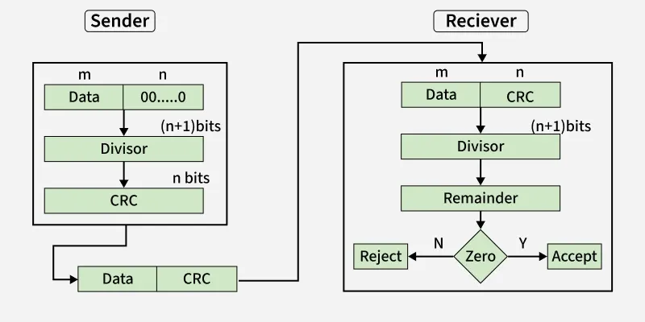
Cyclic Redundancy Check (CRC)
Based on binary division
CRC bits
Make it divisible by a predetermined binary number
https://www.geeksforgeeks.org/computer-networks/error-detection-in-computer-networks/

Slide 12
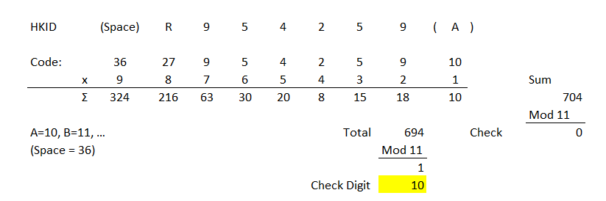
Other Detection Method: Check Digit Method
Redundancy check for error detection
Hong Kong ID - Divisible by 11
https://en.wikipedia.org/wiki/Hong_Kong_identity_card

Slide 13
Medium Access Control

Slide 14
Multiple Access
How can multiple users share a link?
Time Division Multiplexing (TDM)
Frequency Division Multiplexing (FDM)
Freq
Freq
n
3
1
2
3
4
…
n
2
1
Time
Time
Notes:
Multiplexing，又稱「多工」 多址接入技術

Slide 15
CSMA/CD
CSMA:
Carrier Sense Multiple Access
Listen before you transmit
CSMA/CD:
CSMA with Collision Detection
Listen while transmitting.
Stop if you hear someone else

Slide 16
CSMA/CD (IEEE 802.3)
If the medium is idle,
transmit.
If the medium is busy,
wait until idle and then transmit immediately.
If a collision is detected while transmitting,
Transmit a jam signal for one slot (= 51.2 μs = 64 byte times)
Wait for a random time and re-attempt (up to 16 times)
Random time = Uniform slots
Truncated Binary Backoff
Collision detected by monitoring the voltage
High voltage ⇒ two or more transmitters ⇒ Collision
⇒ Length of the cable is limited to 2.5km
Notes:
IEEE 802.3 = Ethernet
64 byte as

Slide 17
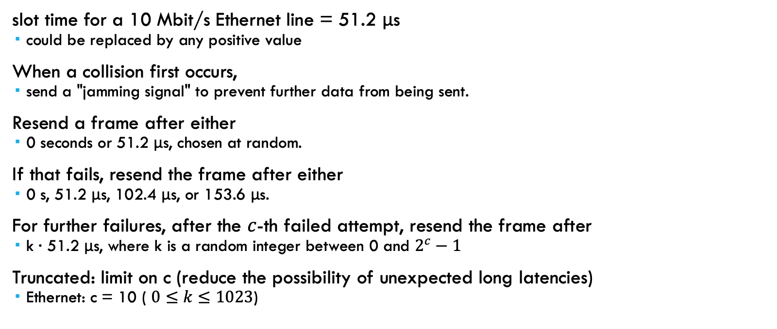
Truncated Binary Backoff
slot time for a 10 Mbit/s Ethernet line = 51.2 μs
could be replaced by any positive value
When a collision first occurs,
send a "jamming signal" to prevent further data from being sent.
Resend a frame after either
0 seconds or 51.2 μs, chosen at random.
If that fails, resend the frame after either
0 s, 51.2 μs, 102.4 μs, or 153.6 μs.
For further failures, after the $c$-th failed attempt, resend the frame after
k · 51.2 μs, where k is a random integer between 0 and $2^{c}−1$
Truncated: limit on c (reduce the possibility of unexpected long latencies)
Ethernet: c = 10 ( $0≤k≤1023$)
Source: https://en.wikipedia.org/wiki/Exponential_backoff
Notes:
This example is from the Ethernet protocol,[3] where a sending host is able to know when a collision has occurred (that is, another host has tried to transmit), when it is sending a frame. If both hosts attempted to re-transmit as soon as a collision occurred, there would be yet another collision — and the pattern would continue forever.
The hosts must choose a random value within an acceptable range to ensure that this situation doesn't happen. An exponential backoff algorithm is therefore used.
Backoff =後退
1 microsecond (mu second) = 1*10^(-6) sec
10 Mbps = 10,000,000 bit / s
64 byte = 64 * 8 bits = 512 bits
512 bits / 10,000,000 (bits / s) = 51.2 * 10^-6 = 51.2 micro second

Slide 18
Multiple Access Links & Protocols
Multiple users can share
Time Division Multiple Access (TDMA)
Frequency Division Multiple Access (FDMA)
IEEE 802.3
CSMA/CD with truncated binary exponential backoff

Slide 19
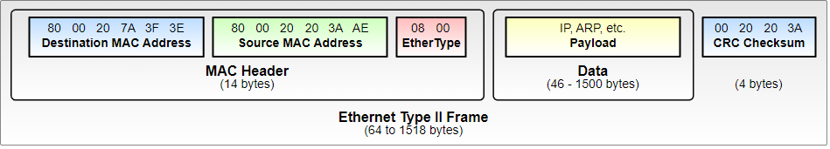
Ethernet Frame Structure
Preamble: 7 bytes with pattern 10101010 followed by one byte with pattern 10101011. To synchronize receiver, sender clocks
Addresses: 6-byte source, destination MAC addresses
Type: indicates higher layer protocol
IP : 0x0800 / ARP: 0x0806
CRC: Cyclic Redundancy Check
If error detected: frame is silently dropped at the receiver
Connectionless: No need to ask the receiver
Unreliable: No acknowledgement (ack), negative acknowledgement (nack), or retransmissions
Notes:
Nack - negative acknowledgment
Preamble =前言

Slide 20
MAC Address
Associated with data link layer
6-byte = 24 bits OUI + 24 bits by OUI owner
Organizationally Unique Identifier (OUI)
Vendor / Manufacturer ID by IEEE
Multicast
“To all bridges on this LAN”
Broadcast
“To all stations”
MAC Address: FF:FF:FF:FF:FF:FF

Slide 21
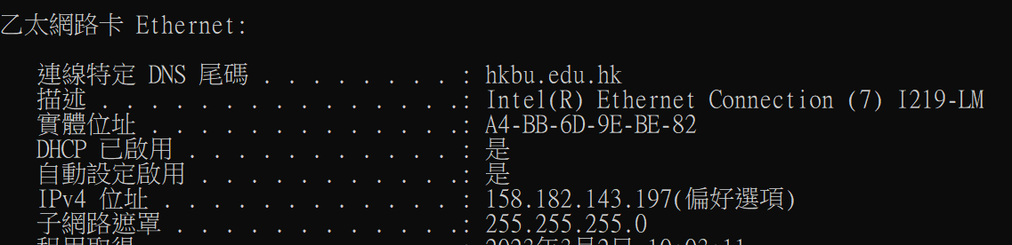
Check IP & MAC Address
ipconfig /all
Terminal / cmd :
Physical Address = MAC Address

Slide 22
Ethernet Standards
Name | IEEE Standard | Data Rate | Media Type | Maximum Distance
Ethernet | 802.3 | 10 Mbps | 10Base-T | 100 meters
Fast Ethernet/ 100Base-T | 802.3u | 100 Mbps | 100Base-TX 100Base-FX | 100 meters 2000 meters
Gigabit Ethernet/ GigE | 802.3z | 1000 Mbps | 1000Base-T 1000Base-SX 1000Base-LX | 100 meters 275/550 meters 550/5000 meters
10 Gigabit Ethernet | IEEE 802.3ae | 10 Gbps | 10GBase-SR 10GBase-LX4 10GBase-LR/ER 10GBase-SW/LW/EW | 300 meters 300m MMF/ 10km SMF 10km/40km 300m/10km/40km
Source: https://www.lantronix.com/resources/networking-tutorials/ethernet-tutorial-networking-basics/

Slide 23
Address Resolution Protocol (ARP)
Goal: Given an IP address find the MAC address
The host broadcasts a request (Dest MAC=FFFFFFFF):
“What is the MAC address of 127.123.125.08?”
The host whose IP address is 127.123.125.08 replies back:
“The MAC address for 127.123.125.08 is 8A:5F:3C:23:45:56”
Nodes cache the MAC-IP mapping in a “ARP table”
arp -a command
list ARP table

Slide 24
Protocols in Data Link Layer
Address Resolution Protocol (ARP)
Reverse ARP (RARP)
Point-to-Point Protocol (PPP)
Wi-Fi
Ethernet

Slide 25
Ethernet Security Concerns
Wired access
Attacking over the cable
Broadcasting nature of LAN
Security of Network, data, and users
Stability of the local network
Man in the Middle attack

Slide 26
Secure the LAN
Physical security
Physical Access control
Segmentation with Virtual LAN
Partition each network by logic in the data link layer
Reference: https://www.grandmetric.com/lan-security-attacks/

